Slide 1
Chapter 10. Networks
Cryptographical architectures. Sensor network security. Trust. Vehicular network threats and defenses. Wireless clouds. SDNs, Virtualization security, NFV. Ecosystem attestation

Slide 2
Network security
Networks implement communication channels with the outside world and interconnect collaborating units
They can be used to send and receive messages, files, web pages,…
Communication mechanisms are part of the operating system: ports, sockets,…
Some of its functions are supported by hardware (IDS, firewalls, Cryptography,…)
Layered architecture defined by international standards (ISO)

Slide 3
Network security functions
Protocols apply cryptography to build secure channels
VPNs provide cryptographic tunnels
IDS (Intrusion Detection Systems) detect attacks in real time and alert the system
Firewalls filter traffic

Slide 4
Use of encryption in the architecture

Slide 5
Cryptography value
Authentication—Can authenticate the identity of users, transactions, and systems.
Protection of messages—Can protect the secrecy of a message and prevent illegal modification. Cannot protect against destruction of the message.
Protection of software and data—Can protect the confidentiality of them although not avoid their destruction. For example, passwords can be encrypted.
Digital signatures—Can authenticate the origin of a message.
Nonrepudiation—A user that signed or otherwise authenticated a document using cryptography cannot deny having sent

Slide 6
Cryptographic architectures
Most of the work on cryptography is about finding better encryption or signature algorithms and protocols to perform some secure operation
Little work exists on the architecture of the systems that implement these algorithms
This is very important because cryptography must work together with the rest of the system to complement other defenses

Slide 7
Encryption mechanism
Encryption is encoding a message to hide its meaning.
Plaintext M is converted into cyphertext C. Formally, C=E(M) and M=D(C) .
The cryptosystem must produce M=D(E(P)) to be useful

Slide 8
Symmetric cryptosystem

Slide 9
Symmetric Encryption Architecture
Encryption protects message confidentiality by making a message unreadable to those that do not have access to the key. Symmetric encryption uses the same key for encryption and decryption.

Slide 11
UC “Encrypt a message”

Slide 12
UC “Decrypt a message”

Slide 13
Public Key systems
The main problem with symmetric encryption is that to be secure, it requires periodic change of the common encryption key
A secure channel is required for key exchange, which makes the scheme inconvenient
The main feature that distinguishes public-key from symmetric-key schemes is the separation of encryption and decryption capabilities.
The public key algorithms use two keys, one of which is public and the other secret. The approach is based on the infeasibility of determining the decryption key given the algorithm and the public key
Instead of permutations and substitutions these algorithms use properties of mathematical functions. In particular, they use the theory of NP functions, those for which there is no known polynomial time solution algorithm. The most famous public key cipher is the RSA cipher developed by Rivest, Shamir, and Adelman, which is used in most current systems. This cipher takes advantage of the difficulty of factoring a large number into primes.

Slide 14
Public key systems
11/3/2018
14

Slide 15
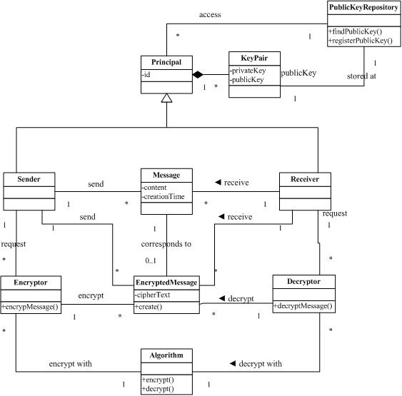
PKI class diagram

Slide 16
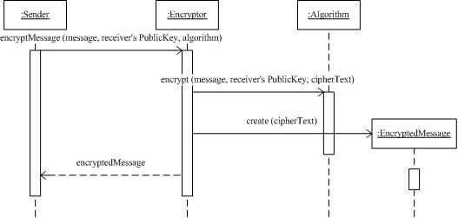
Use case “Encrypt a message”

Slide 17
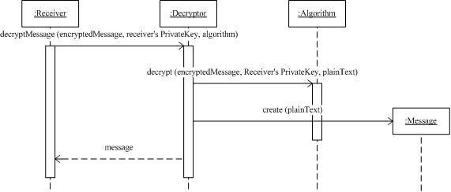
Use case “Decrypt a message”

Slide 18
Digital signatures
PK algorithms have the property that the roles of the keys can be reversed; that is, D(E(M)) = E(D(M)) = M. This is the basis for digital signatures.
The sender does: SIG = D private key(M)
Now using E which is known, everybody can recover M. However, only the sender could have signed it, since only he knows the private key, that is, the signature verification scheme is:
M =? E public key (SIG)

Slide 19
A pattern for Digital Signature with Hashing
Intent
Digital Signature with Hashing allows a principal to prove that a message was originated from it. It also provides message integrity by indicating whether a message was altered during transmission.
Forces
For legal or business reasons we need to be able to verify who sent a particular message. Otherwise, we may not be sure of its origin and the sender may deny having sent it (repudiation).
Messages may be altered during transmission, so we need to verify that the data is in its original form when it reaches its destination.
The length of the signed message should not be significantly larger than the original message; otherwise we would waste time and bandwidth.
Producing a signed message should not require a large computational power or take a long time.

Slide 20
Solution
Apply properties of public key cryptographic algorithms to messages in order to create a signature that will be unique for each sender [Sta06]. The message is first compressed (hashed) to a smaller size (digest), and then it is encrypted using the sender’s private key. When the signed message arrives at its target, the receiver verifies the signature using the sender’s public key to decrypt the message, if it produces a readable message, it could only have been sent by this sender. The receiver then generates the hashed digest of the received message and compares it to the received hashed digest: if it matches the message has not been altered.
This approach uses public key cryptography where one key is used for encryption and the other key for decryption. To produce a digital signature (SIG), we encrypt (E) the hash value of a message (H(M)) using the sender’s private key (PrK): SIG = E_{PrK} (H(M))

Slide 21
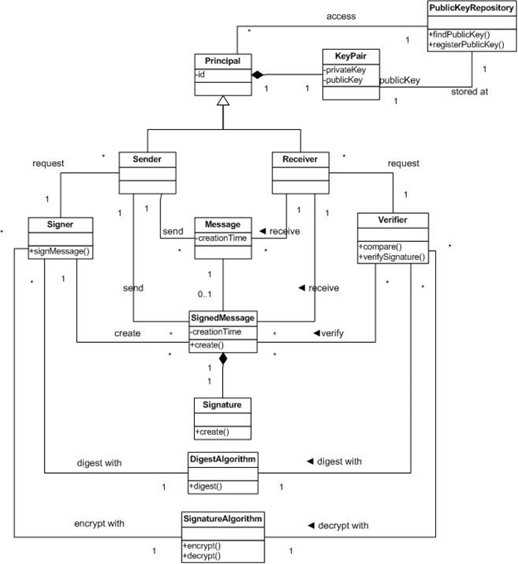
Class diagram

Slide 22
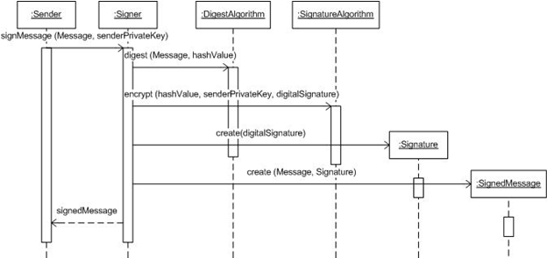
Use case “Sign a message”

Slide 23
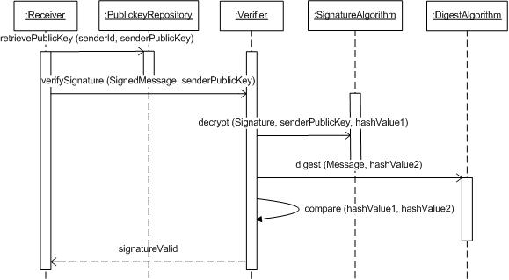
Use case “Verify a signature”

Slide 24
Known uses
Adobe Reader and Acrobat [Ado05] have an extended security feature that allows users to digitally sign PDF documents.
CoSign [Arx] digitally signs different types of documents, files, forms, and other electronic transactions.
GNuPG [Gnu] digitally signs e-mail messages.
The Java Cryptographic Architecture [Sun] includes APIs for digital signature.
Microsoft .Net [Mic07] includes APIs for asymmetric cryptography such as digital signature.
XML Signature [W3C08] is one of the foundation web services security standards that defines the structure and process of digital signatures in XML messages.

Slide 25
Secure channels
11/3/2018
25

Slide 26
IPsec
IPsec defines security protocols for the IP layer and can be used with TCP or UDP. It provides for confidentiality, authentication, and key management. It can also be used to build VPNs (see later).
Its advantages include being transparent to applications and to users because it is below the transport layer.
Two protocols provide security: an authentication protocol using the message header (AH) and an encryption/authentication protocol, the Encapsulation Security Payload (ESP).

Slide 27
Secure Sockets Layer/Transport Layer Security
SSL was developed by Netscape to provide message con­fidentiality and integrity. SSL has now been replaced by TLS which is an IETF standard.
SSL/TLS is a transport layer protocol: It encrypts the traffic between two communicating applications using symmetric cryptography.
SSL/TLS is positioned just above TCP. In many cases it is used to encrypt communication between a web browser and a web server. However, its application is not restricted to the Web — in principle it is possible to use it between any two parts of a communicating application
It is used for web browsing, email, fax, instant messaging, and Voice-over-IP

Slide 28
TLS subprotocols
The SSL/TLS Record Protocol is responsible for encryption between the two endpoints of the communications channel.
The SSL/TLS Handshake Protocol authenticates the parties who will be communicating, and negotiates an encryption algorithm and keys to use during communication.
The handshake protocol has two sub-protocols.
The change cipher spec protocol is used to change the encryption being used by the client and server. It is normally used as part of the handshake protocol to switch to symmetric key encryption. The CCS protocol is a single message that tells the peer that the sender wants to change to a new set of keys, which are then created from information exchanged by the handshake protocol.
The alert protocol is used to alert status changes to the peer. The primary use of this protocol is to report the cause of failure. Status changes include such things as error condition like invalid message received or message cannot be decrypted, as well as things like the connection has closed

Slide 29
Issues
Authentication applies to principals. Principals are users, host machines, sites, processes.
Principals must mutually authenticate.
Users authenticate themselves to hosts and services.
Authentication information must be protected.
Individual messages may need to be authenticated.

Slide 30
TLS (SSL) protocol pattern

Slide 31
UC: Request service

Slide 32
A TLS attack: heartbleed
OpenSSL is an open-source cryptographic library for the implementation of SSL/TLS. The OpenSSL main library was written in the C programming language and has had many released versions.
OpenSSL has had several notable vulnerabilities and the Heartbleed vulnerability has had the most serious impact
Heartbleed is an attack of the heartbeat extension of OpenSSL, where a message is sent to another node that is echoed back to assure the sender that the receiver is working
A Heartbeat is a well-known reliability mechanism, described by a pattern in (Buckley and Fernandez 2009: Acknowledgement pattern).
This vulnerability results from improper input validation (lack of bounds check) in the implementation of the TLS heartbeat extension (OpenSSL, Wikipedia).
Heartbleed is registered in the Common Vulnerabilities and Exposures system as CVE-2014-0160 (CVE).
While this extension is an implementation feature of OpenSSL, it is possible that other protocols may use heartbeats in the future, in which case designers should know how to avoid a potential vulnerability. This possibility makes this attack a pattern as opposed to just an incident.

Slide 33
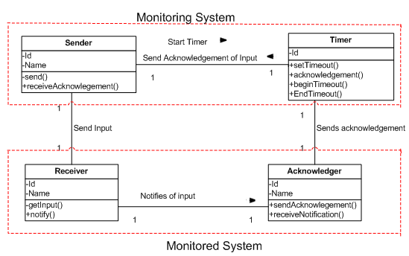
Acknowledgement pattern

Slide 34
Acknowledgement description
The Sender in conjunction with the Timer constitutes the Monitoring system. The Sender is responsible for contacting the monitored system.
The Timer is responsible for counting down the timeout period every time an input is provided to the monitored system. When the timeout period expires for N consecutive times without receiving an acknowledgement from the monitored system, the timer detects an error on the Monitored system and notifies the sender.
The Receiver in conjunction with the Acknowledger entity constitutes the Monitored system. The Acknowledger is responsible for sending an acknowledgement to the timer every time the monitored system receives an input.

Slide 35
A TLS misuse pattern: “Heartbleed”
Intent
In the Heartbleed attack, the attacker modifies the length of the payload of the heartbeat to receive a much longer amount of information from the server (instead of just a short message). The attacker will be able to read protected memory from web servers running one of the OpenSSL vulnerable versions and thus maybe collect some sensitive information.
Context
In an OpenSSL secure connection, the person’s device that visits a website sends a “heartbeat request” message periodically during the lifetime of the connection. The message contains an arbitrary field that defines the payload length “payload_length”.
The corresponding “hearbeat_response” message is sent from the destination website on the other end that has the same copy of the “payload_length” to make sure that the connection is still active.
Figure 1 shows a class diagram for the basic architecture of OpenSSL secure communication after establishing the connection with the client and the server to set a Secure Channel. The client initiates a Heartbeat Request and sends it to the Server. OpenSSL takes the request through the Secure Channel that was established during the connection then sends back the Heartbeat Response to the Client.

Slide 36
Class diagram for Heartbeat connection in OpenSSL

Slide 37
TLS heartbleed attack

Slide 38
Use case: Heartbleed attack
Summary: The Attacker, who impersonates the client, sends a Heartbeat request with a “Modified_Payload_Length” that includes a false length in order to get more information from the attacked server. The OpenSSL process receives the input that includes the false length and sends back information located in the server’s memory which may include sensitive information.
Actor: Attacker
Description:
The Client sends a Heartbeat request including a payload and its length to the server.
The Attacker intercepts the Heartbeat message and modifies the Payload Length (to its maximum value, 64K) and waits for the server’s response. The server does not know whether the client on the other side of the connection is the actual client or an impostor and responds sending an amount of information defined by the Modified Payload Length (long response).
Postcondition:
The attacker may have obtained some sensitive information for the attacker.

Slide 39
Consequences
The success of this attack results in:
The attacker can impersonate a client or even be a legitimate client, access the server and view sensitive information.
Once the attack is successful, the attacker may get the user credentials and can use those in attacking other systems.
Disadvantages (for the attacker) include:
If the attacker does not know that the server is not using a vulnerable OpenSSL version, he might be identified by using the logging system.

Slide 40
Virtual Private Networks
VPNs make use of public network resources to access the internal nodes of an enterprise. The transmission is protected through a cryptographic tunnel that provides message confidentiality and integrity.
Based on cryptographic tunneling -- from client to server directly or through tunnel-enabled access servers
Tunneling protocols : IPSec, TLS, Microsoft PPTP and Cisco L2F, Secure Shell (SSH) VPN.
Most VPN products do authentication of tunnel end points
VPNs can run at level 4 (SSL) or 2(IP)

Slide 41
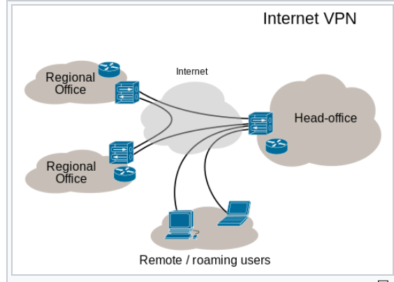

Slide 42
A VPN provides:
Confidentiality such that even if the network traffic is sniffed at the packet level, an attacker would see only encrypted data
Sender authentication to prevent unauthorized users from accessing the VPN
Message integrity to detect any instances of tampering with transmitted messages

Slide 43
Pattern diagram for VPNs

Slide 44
Abstract Virtual Private Network (VPN) [Kum10]
Intent
This pattern sets up a secure channel between two endpoints using cryptographic tunneling, with authentication at each endpoint. An endpoint is an interface exposed by a communicating unit (user site or network).
…
Known Uses
Citrix provides a site to site SSL VPN connection for remote users to log into the secure network as well as access applications on the company (secure) network [Cit].
Cisco VPN uses an IPSec VPN and they provide authorization [Cis]
Nokia provides a VPN connection for Nokia Mobile Users.

Slide 45
Class diagram for the VPN security pattern

Slide 46
Blocking VPNs
Can be done a few different ways. Ports that are used by common VPN tunneling protocols, such as PPTP or L2TP, to establish their connections and transfer data can be closed by system administrators to prevent their use on certain networks.
Similarly, a website can prohibit access to its content by blocking access from IP addresses that are known to belong to popular VPN providers.
Some governments block all access to foreign IP addresses, since VPN use often entails connecting to remote hosts that do not operate under that government's jurisdiction. This is done in the Great Firewall of China, which also does deep packet inspection (checks packet contents).

Slide 47
Intrusion Detection Systems (IDSs)
A device or software system that monitors a network or systems for malicious activity or policy violations.
Any malicious activity or violation is typically reported either to an administrator or collected centrally using a Security Information and Event Management (SIEM) system. A SIEM system combines outputs from multiple sources, and uses data analytics techniques to distinguish malicious activity from false alarms (to be seen).
Some IDS products have the ability to respond to detected intrusions. Systems with response capabilities are typically referred to as an intrusion prevention system (IPS).

Slide 48
Types of IDS
Statistical anomaly detection --based on profiles of normal user and system behavior. Events that deviate from this behavior are considered suspicious. The profiles are built from past audit logs.
Rules-based (knowledge based) detection -- based on sequences of events (attack signatures), that correspond to known types of attack.
11/3/2018
48

Slide 49
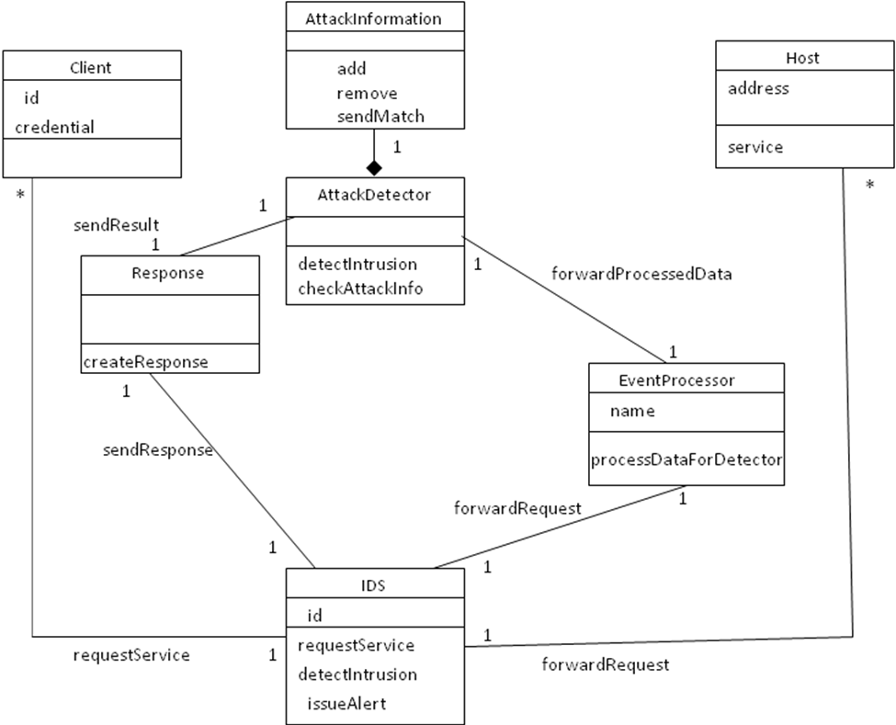
Class diagram for the Abstract IDS security pattern

Slide 50
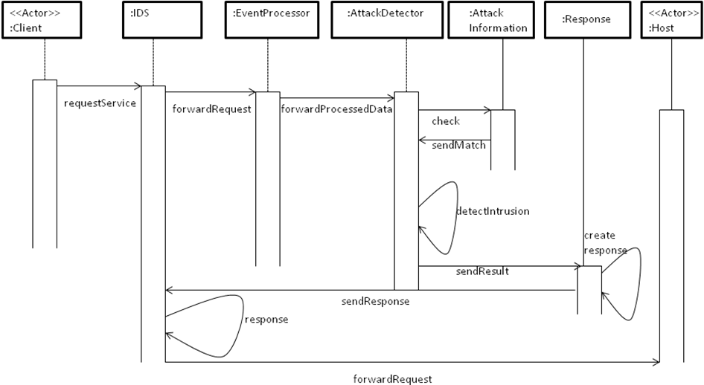
Sequence diagram for detecting an intrusion with Abstract IDS

Slide 51
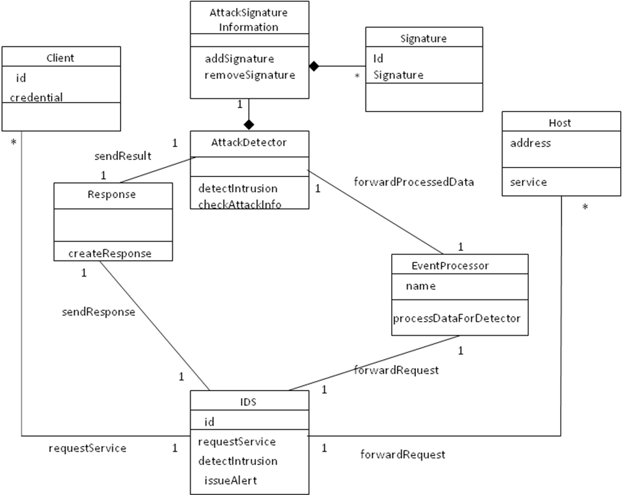
Class Diagram for Pattern for Signature-based IDS

Slide 52
Firewalls
Firewalls control access from networks to internal systems (boundary protection)
Network layer firewall --analyzes packets
Application layer firewall -- uses application proxies
Stateful firewall-- keeps the state of connections
11/3/2018
52

Slide 53
Network layer firewall
11/3/2018
53

Slide 55
Application (Proxy) layer firewall
Uses security proxies to represent services
Uses a variety of the Proxy pattern
Prevents direct access
Analyzes application commands
Keeps logs for later auditing
Poor scalability
Complex if no proxies are available
11/3/2018
55

Slide 56
Application layer firewall
11/3/2018
56

Slide 58
Application (user) firewall
Controls input/output from distributed applications
Enforces access control according to application restrictions, can understand application semantics
Can also filter wrong operations, wrong type or length parameters, wrong sequences of operations

Slide 61
Wireless Sensor Networks (WSNs)
A wireless sensor network (WSN) is a deployment of a large number of small, inexpensive, self-powered devices that can sense, compute, and communicate with other devices for the purpose of gathering local information, used to make global decisions about a physical environment.
Research on sensor networks was originally motivated by military applications, such as acoustic surveillance and target detection.
However, WSNs have many other applications such as infrastructure security, environmental monitoring, vehicle traffic analysis,…

Slide 62
Sensor node structure
Transceiver
Sensor
Power Source
Processor
ADC
Memory
Sensor

Slide 63
Sensor node pattern

Slide 64
A sensor network

Slide 65
Sensor network architecture

Slide 66
Advantages
If some nodes cannot reach the sink directly, other nodes can help them by relaying their data.
Clusters allow the management or securing of sec­tions of the network by deﬁning a cluster head that can control different functions.
Specialized, resource-rich nodes (called supernodes in this paper) can be inserted in the network. For example they can have more processing power to do ﬁltering, to keep logs, or to store authentication information, or they can have a larger communication range. Using supernodes, the WSN could achieve better performance such as longer network lifetime, better latency, and reliability [Sta05].
The model is also suitable for simulations.
Depending on the application requirements, a WSN can have more or less number of sensor nodes and it can be homogeneous or heterogeneous. Architectures using clusters or supernodes are scalable with the number of sensor nodes. The number of supernodes deployed will depend on the network size.
Depending on the application requirements, the WSN can be extended with security mechanisms.
Organizing the sensors in a WSN provides a cost efficient solution, since the same sensor nodes are used both in data sensing and data relaying.

Slide 67
Digression: Trust and reputation
Trust
-- Reliance on the character, ability, strength, or
truth of someone or something
Trust is a particular level of the subjective probability with which an agent assesses that another agent will perform a particular action in a context that affects his actions
Reputation
Expectation about an entity’s behavior based on past behavior
May be used to determine trust

Slide 68
Role of Trust Management
Each entity (peer) must protect itself against threats
Trust Management can serve as a potential countermeasure
Trust relationships between peers help establish confidence
Two types of decentralized trust management systems
Credential and policy-based (we saw an example in the Identity Circle of Trust)
Reputation-based

Slide 69
Trust in secure systems
Trust is an important concept when designing secure systems; it defines the parts of the system which we can use as a basis to build the system (they can be verified in detail if they are small). All secure systems must have a Trusted Computing Base (TCB), which provides a set of trusted functions. The TCB must be as small as possible so we can verify it.
The TCB is usually part of the operating system but other systems such as databases and networks may also have TCBs.
Lampson et al. define the TCB as: a small amount of software and hardware that security depends on and that we distinguish from a much larger amount that can misbehave without affecting security.

Slide 70
Trusted Computing Base(TCB)
The part of the system which we trust
Kernel: includes all security-related functions
Kernel Verification: possible only for relatively simple systems, and requires special languages and special operating systems (we will see a verified kernel for smart phones)
In practical systems we need to trust some part of the OS or another component of the system
Network nodes need to develop trust in another nodes
Clients of web services need to trust these services (to be seen)

Slide 71
Use of kernels
DBMS
DBMS Kernel
Sec. Kernel
OS
OS Kernel

Slide 72
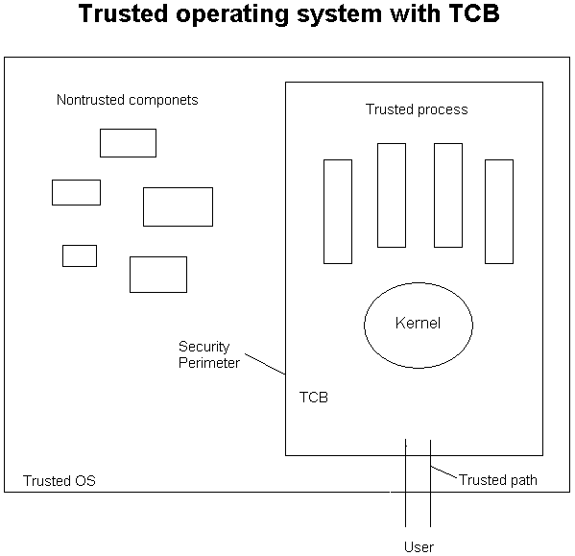

Slide 73
Use cases of WSNs
Send message from node A to aggregation node
Send message from aggregation node to sink (base station)
Aggregate data (in some nodes)
Optimal routing of messages
Collect data from aggregation nodes
Manage sensor nodes (health, battery, activation,…)
Anonimity (in some cases)

Slide 74
Threats in WSNs [Den14]
Physical layer
Jamming—RF interference to disrupt communication
Tampering—Physical access to destroy, get information, alter or replace node
Network layer
Selective forwarding—A malicious node rejects to forward or drops the messages it receives
Sinkhole attack—make a compromised node appear attractive for routing
Sybil attack—a node replicates itself and takes several locations
Wormhole attack—the attacker tunnels packets to another location and replays them to simulate the two nodes are very close
Hello flood attack—the attacker makes nodes believe they are neighbors

Slide 75
WSN threats II
Transport layer
Flooding—the attacker makes connection requests over and over to deplete the resources of a node
Desynchronization—the attacker repetitively pushes messages which convey sequence numbers to the end points

Slide 76
Vehicular networks security [Gad13]
Vehicular networks are a type of CPS where vehicles must have some interface that enables short range wireless ad-hoc networks (VANETs) and detailed position information (GPS).
These networks also require some type of fixed roadside infrastructure
Clouds are being proposed as roadside infrastructure [Abi11]

Slide 77
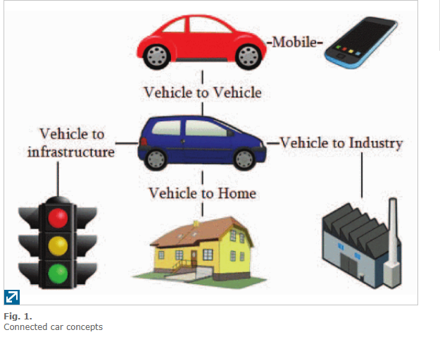

Slide 78
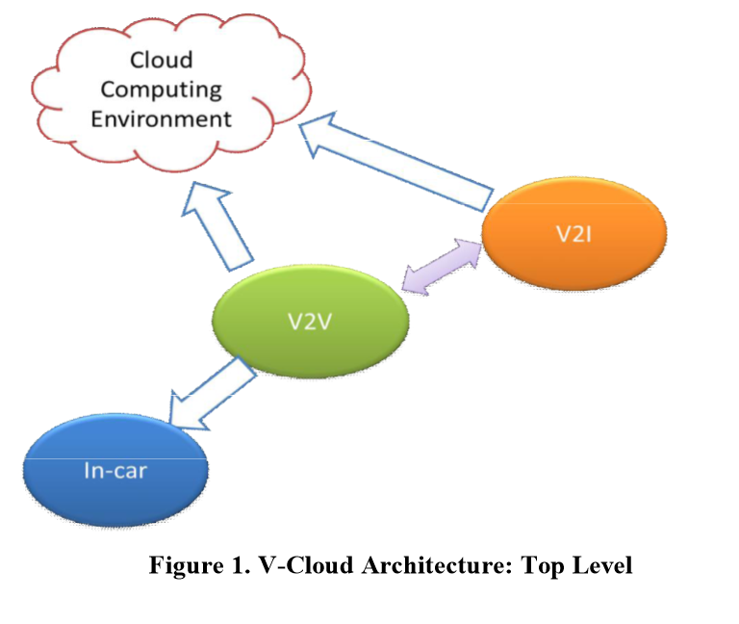

Slide 79
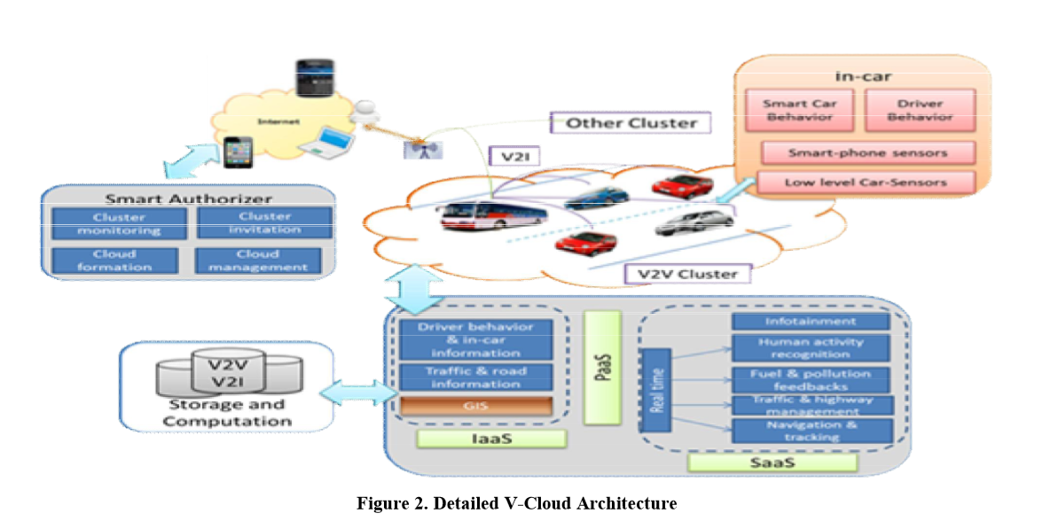

Slide 80
Some use cases for vehicular networks
Platooning-- the linking of two or more trucks in convoy, using connectivity technology and automated driving support systems.
Collision reporting/avoidance
V2V communication
Traffic optimization—vehicles can report on traffic conditions
Localization of services—closest fuel station, restaurant, or hotel
Safety warning and monitoring
Bridge monitoring
Highway entries/exits
Payment services

Slide 81
Threats for vehicular networks [Sho16]
DoS—a malicious car sends repeatedly messages
DDoS—multiple vehicles attack one vehicle
False information—end wrong traffic information
Black hole—data is lost in the black hole
Timing—delay emergency messages
Man-in-the-middle attack—a malicious car inserts wrong information between communicating vehicles
Wormhole—malicious vehicles control the network
Sybil—messages seem to come from different vehicles
GPS spoofing—a vehicle thinks it is in the wrong place
Impersonation—a vehicle takes the identity of another vehicle
Illusion—make up of warning messages

Slide 82
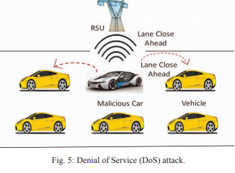

Slide 83
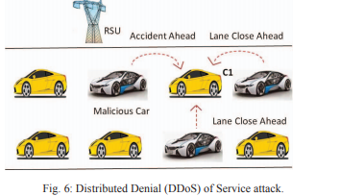

Slide 84
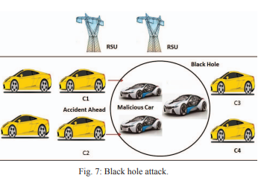

Slide 85
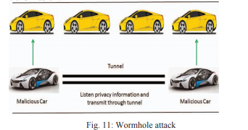

Slide 86
Threats in vehicular networks
This paper, [Sho16], shows a list of possible threats with descriptive diagrams.
This is not systematic, threats should be related to use cases or architectural levels.
The descriptions are given as a few words and diagrams. This is imprecise, misuse patterns would make this work much more useful.

Slide 87
Software Defined Networks (SDN)
It is an emerging architecture for networks that separates the control from the data in switches and routers. Under SDN, the control plane is implemented in software in servers separate from the network equipment and the data plane is implemented in commodity network equipment.
In routing, the control plane is the part of the router architecture that is concerned with drawing the network map, or the information in a (possibly augmented) routing table that defines what to do with incoming packets.
Control plane functions, such as participating in routing protocols, run in the architectural control element. In most cases, the routing table contains a list of destination addresses and the outgoing interface(s) associated with them.
Control plane logic also can define certain packets to be discarded, as well as preferential treatment of certain packets for which a high quality of service is defined by such mechanisms as differentiated services.

Slide 88
Software Defined Networks (SDN) II
Network intelligence is (logically) centralized in software-based SDN controllers, which maintain a global view of the network. As a result, the network appears to the applications and policy engines as a single, logical switch.
With SDN, enterprises and carriers gain vendor-independent control over the entire network from a single logical point, which greatly simplifies the network design and operation.
SDN also greatly simplifies the network devices themselves, since they no longer need to understand and process thousands of protocol standards but merely accept instructions from the SDN controllers

Slide 89
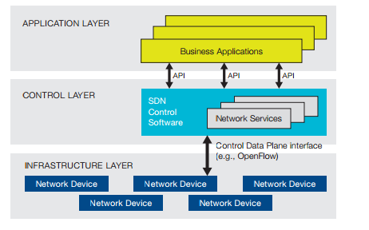
Software Defined Network (SDN) Architecture

Slide 90
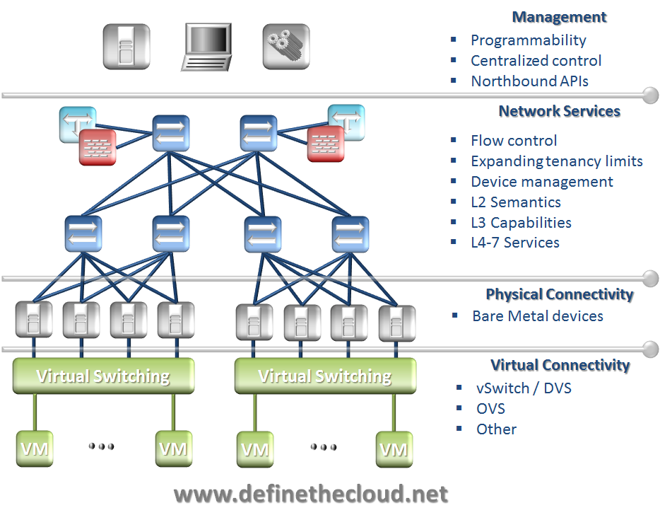

Slide 91
SDN security
SDN can make it easier to collect network usage information, which could support improved algorithm design used to detect attacks.
The new generation of applications will take advantage of better-informed SDN agents to improve policy enforcement and traffic anomaly detection and mitigation.
These applications may be able to block malicious intruders before they enter the critical regions of the network.
The biggest benefit of SDN-enabled security is that it presents an opportunity for intelligent response on a granular basis by selectively blocking malicious traffic while still allowing normal traffic flows.
The next figure [Kre2013] shows some threats.

Slide 92
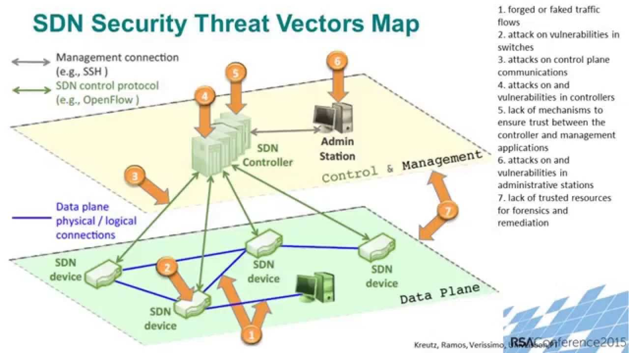

Slide 93
SDN threats [Kre13]
Forged or fake traffic flows—can be used to attack switches and controllers
Attacks on vulnerabilities on switches—a switch can drop or slow down packets, clone or deviate traffic, or inject forged traffic or requests
Attacks on control plane communications—generate DoS attacks or data theft
Attacks on vulnerabilities in controllers—can compromise the whole network
Lack of mechanisms to ensure trust between the controller and management applications—can lead to DoS attacks
Attacks on vulnerabilities in administrative stations—can reprogram network

Slide 94
Data plane attacks
Attackers could target the network elements from within the network itself. An attacker could theoretically gain unauthorized physical or virtual access to the network or compromise a host that is already connected to the SDN and then try to perform attacks to destabilize the network elements. This could be a type of Denial of Service (DoS) attack or it could be a type of fuzzing attack to try to attack the network elements.
There are numerous southbound APIs and protocols used for the controller to communicate with the network elements. These SDN southbound communications could use OpenFlow (OF), Open vSwitch Database Management Protocol (OVSDB), Path Computation Element Communication Protocol (PCEP), Interface to the Routing System (I2RS), BGP-LS, OpenStack Neutron, and others.

Slide 95
Attacks at Controller Layer
An attacker would try to target the SDN controller for several purposes. The attacker would want to instantiate new flows by either spoofing northbound API messages or spoofing southbound messages toward the network devices. If an attacker can successfully spoof flows from the legitimate controller then the attacker would have the ability to allow traffic to flow across the SDN at their will and possibly bypass policies that may be relied on for security.
Often times, SDN controllers run on some form of Linux operating system. If the SDN controller runs on a general purpose operating system, then the vulnerabilities of that OS become vulnerabilities for the controller.

Slide 96
Attacks at SDN Layer
Attacking the security of the northbound protocol would also be a likely vector. There are many northbound APIs that are used by SDN controllers. Northbound APIs could use Python, Java, C, REST, XML, JSON, among others. If the attacker could leverage the vulnerable northbound API, then the attacker would have control over the SDN network through the controller. If the controller lacked any form of security for the northbound API, then the attacker might be able to create their own SDN policies and thus gain control of the SDN environment.
Often times, there is a default password that is used for a REST API which is trivial to determine. If an SDN deployment didn’t change this default password and the attacker could create packets toward the controller’s management interface, then the attacker could query the configuration of the SDN environment and put in their own configuration.

Slide 97
Network Functions Virtualization
The provision of network functions using virtualization, Network Functions Virtualization (NFV), is a network architecture where node functions such as load balancers, firewalls, IDS, and accelerators are built in software and offered as services
Each Virtualized Network Function (VNF) may use one or more virtual machines or containers running different software
This approach results in reduced complexity in network design, reduced cost, better scalability and faster deployment
Note that this is virtualization using the services of the cloud at any level; it is not about virtualizing processors and networks as it is done normally in the cloud itself in its PaaS level. Of course, NFV can be performed using a dedicated cloud using its PaaS functions.

Slide 98
Going from hardware to software

Slide 99
NFV advantages
Heterogeneity—by implementing standardized functions a good part of this heterogeneity disappears, all the functions are handled uniformly.
Lifecycle—software-implemented functions are not affected by hardware technological changes
Security—a unified system can be protected in a systematic way using institution policies that are applied to all devices. It is possible to have different degrees of security, tailored to different types of users or applications. The reduced complexity also contributes to security.
Reliability/availability—error propagation is easier to contain, a hardware failure can be solved by restating a VM in another hardware.
Scalability (elasticity)—increasing the number of units just requires making more software copies and can be dynamic.
Extensibility—adding new functions requires new software that might not even have any hardware counterpart. New functions are pluggable units.

Slide 100
NFV advantages II
Development—new vendors can develop products conveniently, without need for complex hardware development and testing facilities.
Location—it is possible to move network functions or instantiate them, anywhere in the network.
Power usage--reduced power usage is obtained by migrating workloads and powering down unused hardware.
Fast time to market—new functions can be set in a short time.
Upgrades—can be applied automatically to all the corresponding functions.

Slide 101
NFV liabilities
There is some performance overhead in providing a VNF as opposed to a function obtained from a hardware device.
Without standardized functions, interoperability may not be possible; i.e. the telcos have to form federations to use NFVs.
There will be new types of security threats. Software in the Internet and in the cloud is subject to a variety of threats, and the specific implementation of the VNFs can bring new threats.

Slide 102
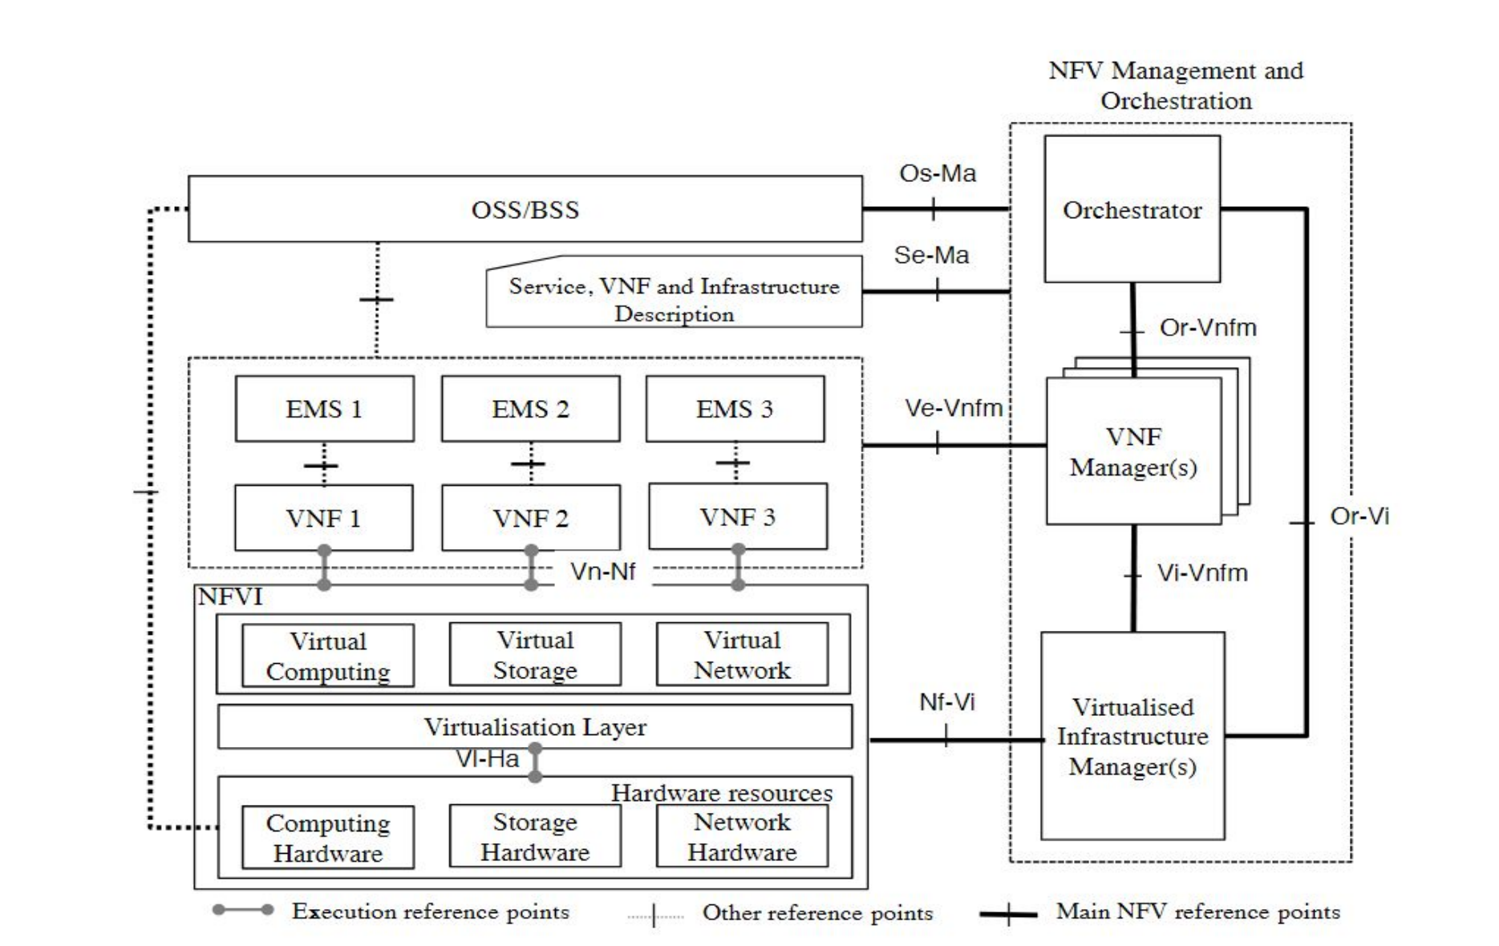
NFV Reference architecture (ETSI)

Slide 103
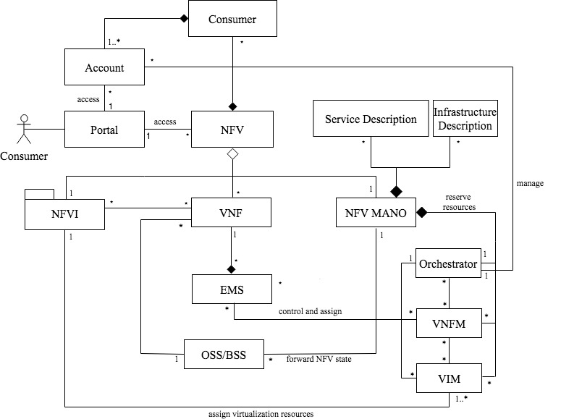
NFV class diagram

Slide 104
The Orchestrator controls user accounts in terms of privileges and billing services.
The MANO is divided into three units, the Orchestrator, the VNFM and the VIM.
MANO controls/manages the virtualization infrastructure as well as assigning virtualized resources to VNF; each VNF is controlled by an Element Management System (EMS).
The Operation Support System and Business Support System (OSS/BSS) is responsible for supporting several business operations such as service fulfillment and billing; while the Service and Infrastructure descriptions are responsible for providing service-related information and NFV infrastructure information.

Slide 105
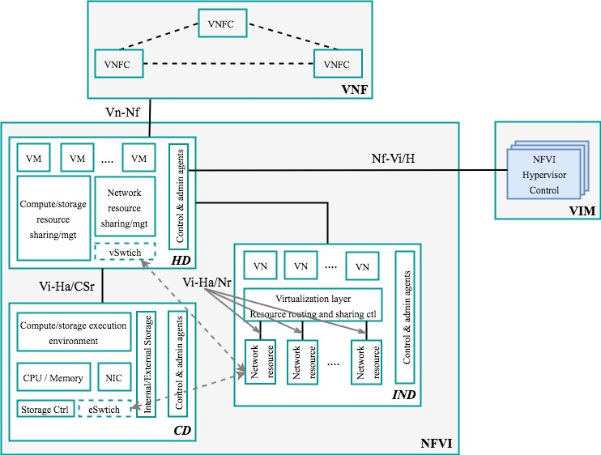
NFVI Reference Architecture

Slide 106
NFVI
The Compute Domain (CD) includes the physical compute and storage resources necessary to provide processing and storage to deploy VNFs. The compute hardware is mainly made of commercial-off-the-shelf (COTS) components, while the storage can be in a form of shared storage or direct attached storage on the server itself.
The Infrastructure Networking Domain (IDN) includes both the physical and virtual networking resources comprising of switchings and routings that interconnect the compute and storage resources within the NFVI.
The Hypervisor Domain (HD) comprises the hypervisor, which decouples the virtual resources from the underlying physical resources, and allocates the compute domain resources to Virtual Machines (VMs). The domain actually can be considered as a software environment where VMs can be created, migrated, and terminated, and where scaling resources and policy enforcement can be performed.

Slide 107
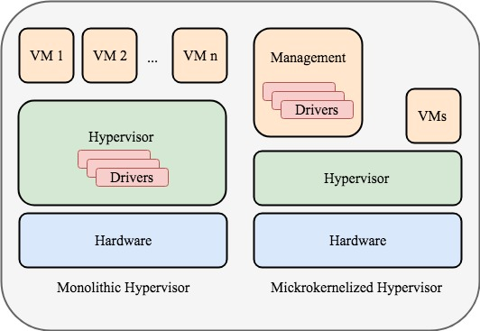
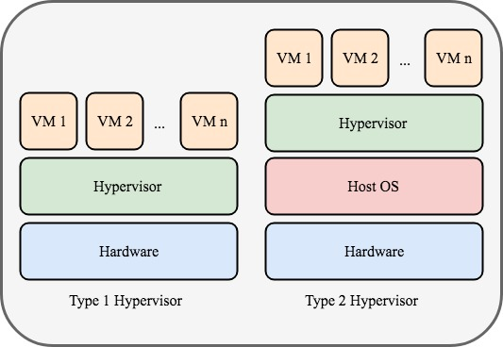
Hypervisor types

Slide 108
NFV threats [Alw18]
T01 Denial of Service (DoS). An attacker takes an excessive amount of resources making the system unable to satisfy requests from other users.
T02 Infrastructure integrity. An attacker pretends to be a service provider to try to appear as part of the real services of NFV to gain access to users’ data
T03 Misuse of resources. Using resource freeing attack, the attacker can free up some resources and uses them for his own beneﬁt
T04 Change in NFV function deﬁnition. An attacker modiﬁes some of the operations in NFV functionality, deﬁnition, or even produces DoS. This is usually done by injection
T05 Privilege modiﬁcation. Privileges of users can be changed using modifying non-control data attack, by upgrading or degrading their access to system entities in unauthorized manner
T06 Conﬁdentiality attack based on shared resources. Using side-channel attack, attackers can pull some private information about other users using a shared service in unauthorized manner
T07 Malicious insider. Trusted members from inside the organization use their authority to access private data of users in unauthorized manner.

Slide 109
References I
[Alw18]Ahmed Alwakeel, Abdulrahman K. Alnaim, E.B.Fernandez, “A survey of NFV security”, IEEE SoutheastCon, 2018, Tampa, FL, April 19-22, 2018, DOI: 10.1109/SECON.2018.8479121
Tamás Bécsi ; Szilárd Aradi ; Peter Gáspár, “Models and Technologies for Intelligent Transportation Systems” (MT-ITS) 3-5. June 2015. Budapest, Hungary, https://ieeexplore.ieee.org/document/7223297
[Bra98] A. Braga, C. Rubira, and R. Dahab, “Tropyc: A pattern language for cryptographic object-oriented software”. Chapter 16 in Pattern Languages of Program Design 4 (N. Harrison, B. Foote, and H. Rohnert, Eds.). 1998.
Mihaela Cardei, E. B.Fernandez, Anupama Sahu, and Ionut Cardei, "A pattern for Wireless System Architectures", Procs. of Asian PLoP 2011, Tokyo, Japan.
M. Denar, “Security analysis in wireless sensor networks”, Int. J. of Distributed Sensors Networks, vol. 2014, ID 303501
E.B.Fernandez, “Security patterns in practice: Building secure architectures using software patterns”, Wiley Series on Software Design Patterns, 2013.
[Kre13] D. Kreutz, F.M.Ramos, P. Verissimo, “Towards secure and dependable software-eefined networks”, HotSDN’13, Hong Kong, China, Aug. 16, 2013

Slide 110
References II
[Abi11] H. Abid, L.T.Phuong, J. Wang, S. Lee, S. Qaisar, “V-Cloud: Vehiular cyber-physical systems and cloud computing”, ISABEL’11, October 26-29, Barcelona, Spain, 2011.
[Gad13] B. Gadekar, R.V. Dharaskar, V.M.Thakare, “A review on security in vehicular network”, Proc. Int. Conf. on Advances in Comm., Network, and Computing, Elsevier 2013
[Kum10] Ajoy Kumar and E.B.Fernandez, "Security patterns for Virtual Private Networks" , Procs. of the 8th Latin American Conference on Pattern Languages of Programs (SugarLoafPLoP 2010), Salvador, Bahia, Brazil, Sept 23-26, 2010
J. Pelaez, E.B.Fernandez, and M.M. Larrondo-Petrie, "Misuse patterns in VoIP", Security and Communication Networks Journal. Wiley, Volume 2, Issue 6, November/December 2009, pp. 635–653, DOI: 10.1002/sec.105
Anupama Sahu, E.B. Fernandez, Mihaela Cardei, and M. VanHilst, "A pattern for a sensor node", Procs. 17th Conf. on Pattern Languages of Programs, PLoP 2010.
Karen Scarfone, Peter Mell, "Guide to Intrusion Detection and Prevention Systems (IDPS)" . Rev. 1 Computer Security Resource Center (National Institute of Standards and Technology) (800-94). 2012 https://csrc.nist.gov/CSRC/media/Publications/sp/800-94/rev-1/draft/documents/draft_sp800-94-rev1.pdf
[Sho16]Ahmed Shoeb Al Hasan , Md. Shohrab Hossain, Mohammed Atiquzzaman, “Security threats in vehicular ad hoc networks”, 2016 Int. Conf. on Advances in Comp. Comm. and Informatics (ICACCI), Jaipur, India, Sept. 2016

